Slide 1
2D TRANSFORMATIONS

Slide 2
2D Transformations
What is transformations?
The geometrical changes of an object from a current state to modified state.
Why the transformations is needed?
To manipulate the initially created object and to display the modified object without having to redraw it.

Slide 3
2D Transformations
Object Transformation
Alter the coordinates descriptions an object
Translation, rotation, scaling etc.
Coordinate system unchanged
Coordinate transformation
Produce a different coordinate system

Slide 4
2D Transformations
Basic Transformations
Translation
Scaling
Rotation
Other transformations
Reflection
Shear
Composite Transformations

Slide 5
Translation
A translation moves all points in an object along the same straight-line path to new positions.
The path is represented by a vector, called the translation or shift vector.
We can write the components:
p'_{x} = p_{x} + t_{x}
p'_{y} = p_{y} + t_{y}
or in matrix form:
P' = P + T
?
=4
t_{y}
t_{x}
= 6
(2, 2)
x’
y’
x
y
t_{x}
t_{y}
= +

Slide 6
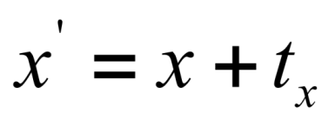
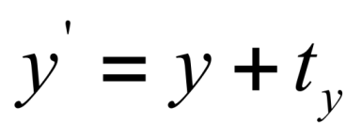
Translation
Translation transformation
Translation vector or shift vector T = (t_{x}, t_{y})
Rigid-body transformation
Moves objects without deformation
y
P’
T
T
p
x

Slide 7
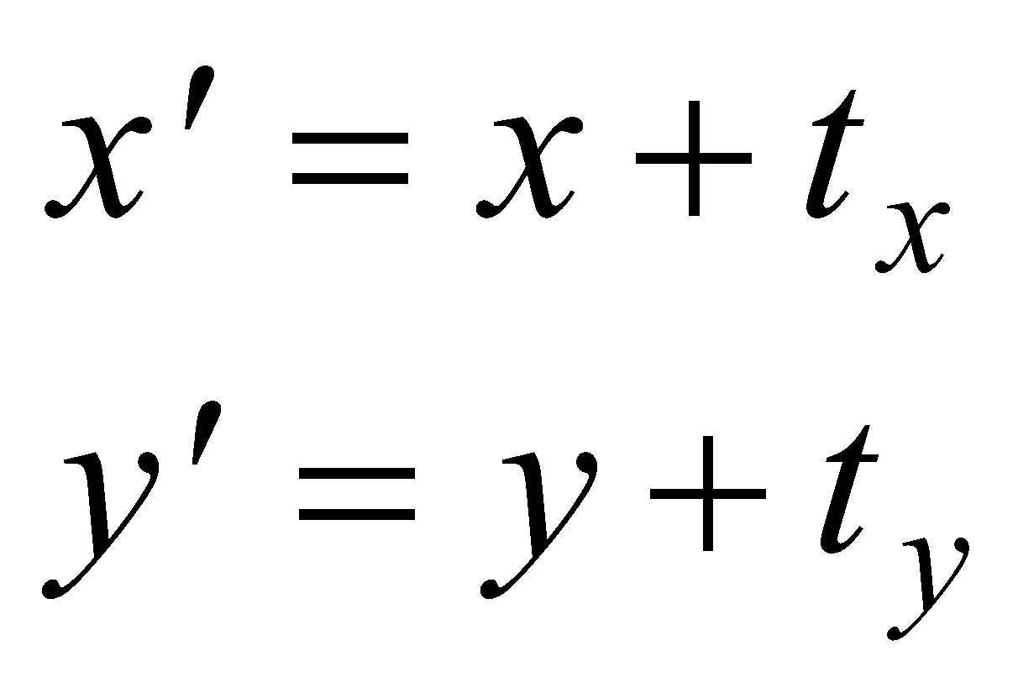
Translation
(55,60)
(20,35)
(45,30)
(65,30)
(10,5)
(30,5)
The vector (t_{x}, t_{y}) is called the offset vector.

Slide 8
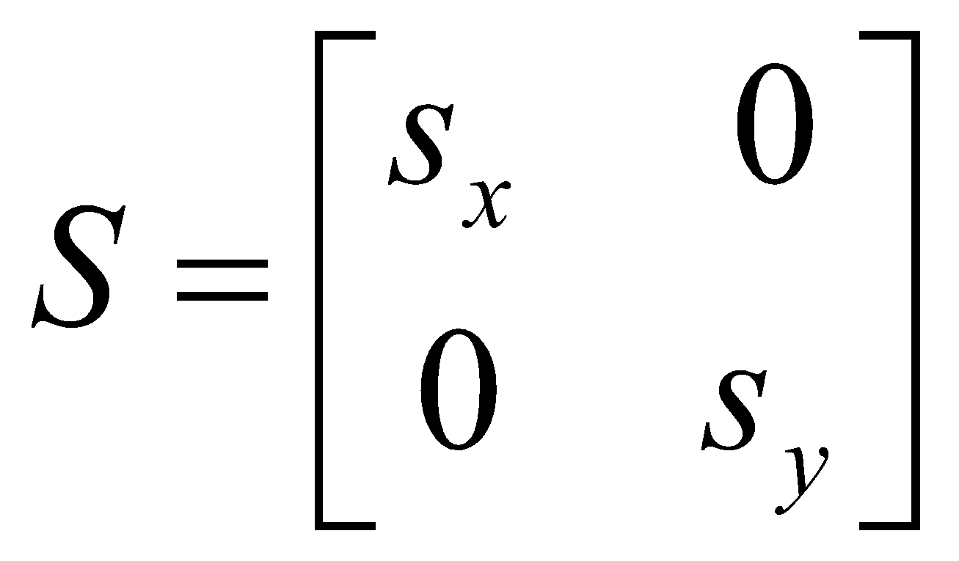
Scaling
Scaling changes the size of an object and involves two scale factors, S_{x} and S_{y} for the
x- and y- coordinates
respectively.
Scales are about the origin.
We can write the components:
p' = s_{x} • p
p'= s_{y} • p
or in matrix form:
P' = S • P
Scale matrix as:
P’
P

Slide 9
Scaling
If the scale factors are in between 0 and 1 ➔ the points will be moved closer to the origin ➔ the object will be smaller.
P(2, 5)
P’
Example :
P(2, 5), Sx = 0.5, Sy = 0.5
Find P’ ?

Slide 10
Scaling
If the scale factors are in between 0 and 1 ➔ the points will be moved closer to the origin ➔ the object will be smaller.
P’
Example :
P(2, 5), Sx = 0.5, Sy = 0.5
Find P’ ?
P(2, 5)
If the scale factors are larger than 1 ➔ the points will be moved away from the origin ➔ the object will be larger.
P’
Example :
P(2, 5), Sx = 2, Sy = 2
Find P’ ?

Slide 11
Scaling
If the scale factors are the same, S_{x} = S_{y} ➔ uniform scaling
Only change in size (as previous example)
P’
If S_{x} ≠ S_{y} ➔ differential scaling.
Change in size and shape
Example : square → rectangle
P(1, 3), S_{x} = 2, S_{y} = 5 , P’ ?
P(1, 2)
What does scaling by 1 do?
What is that matrix called?
What does scaling by a negative value do?

Slide 12
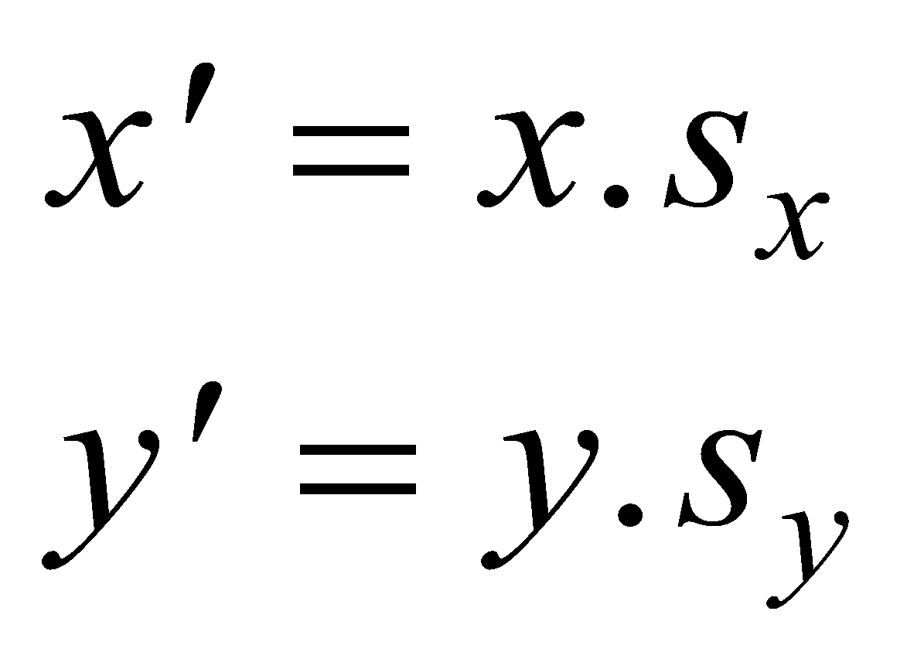
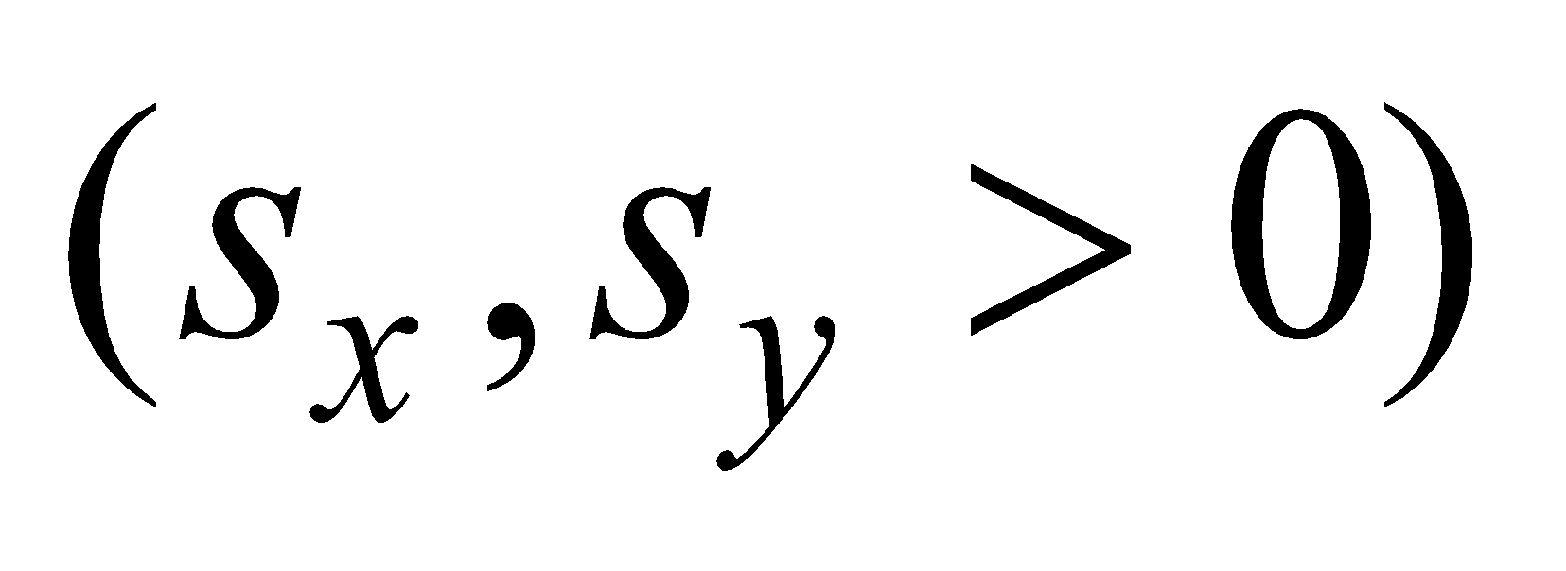
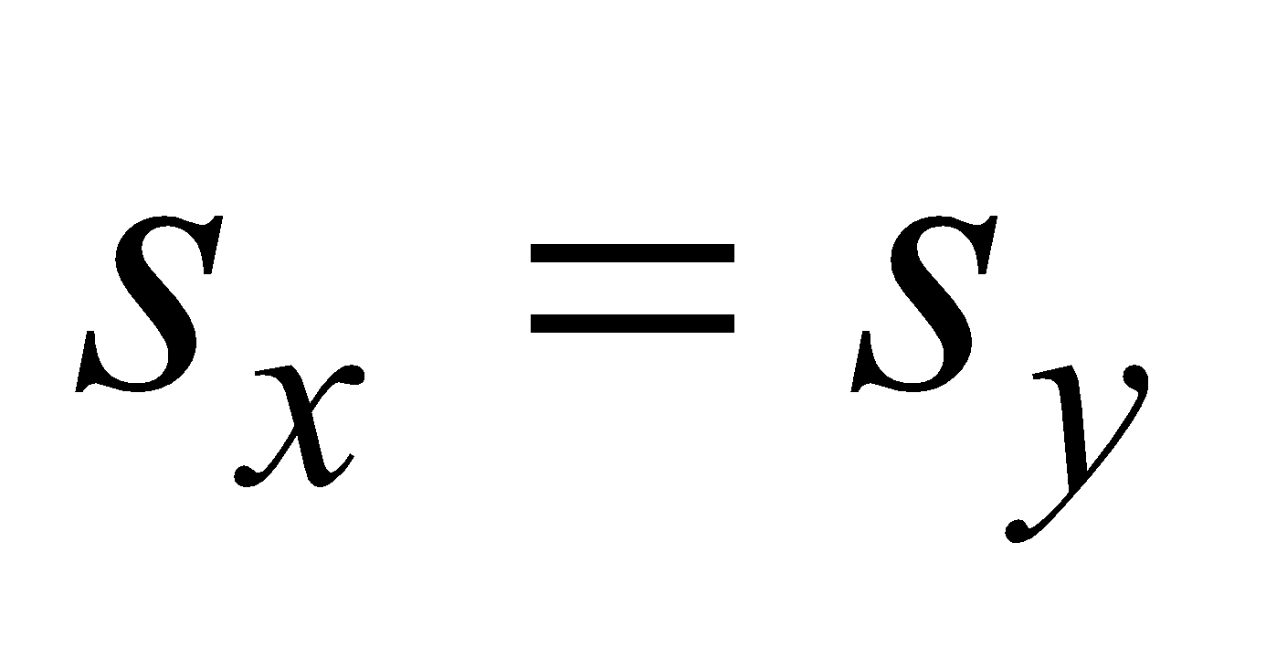
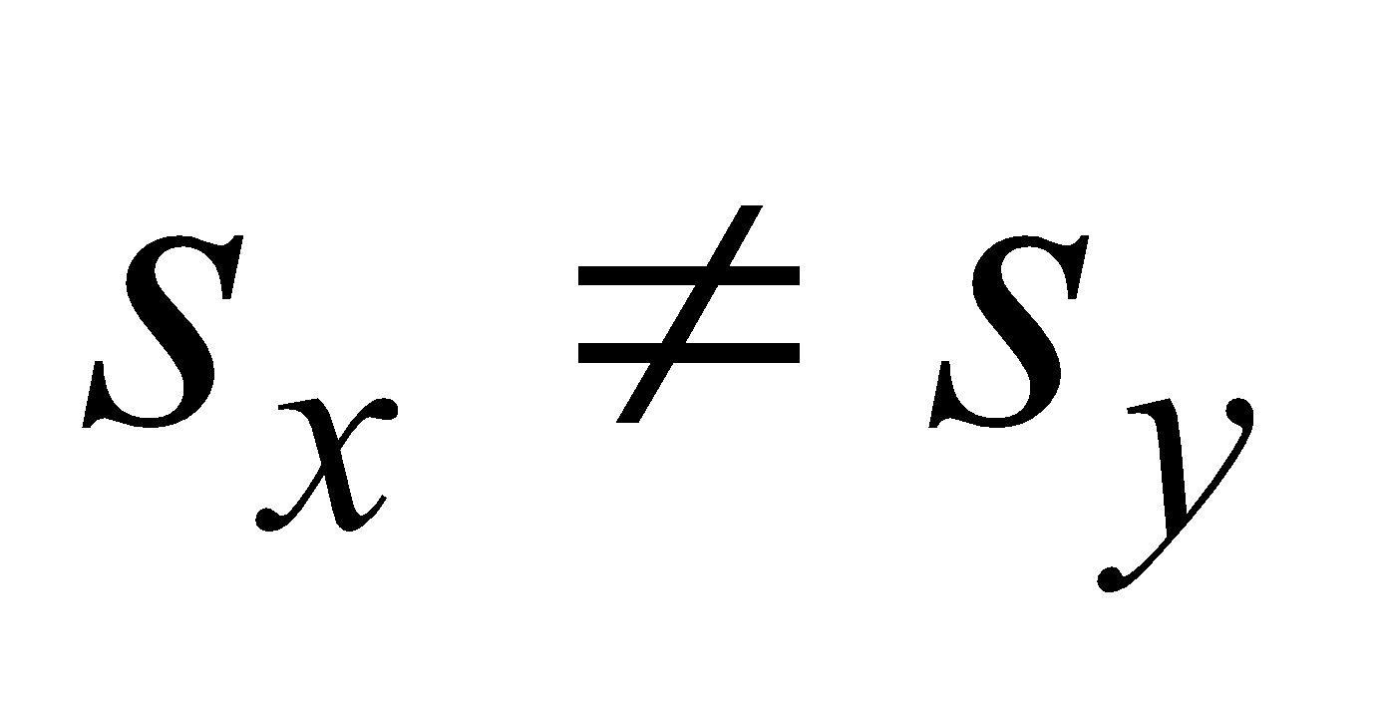
Scaling About the Origin
(x’,y’)
(x,y)
(x,y)
(x’,y’)
Uniform
Non-Uniform
The parameters s_{x}, s_{y} are called scale factors.

Slide 13
Rotation
A rotation repositions all points in an object along a circular path in the plane centered at the pivot point.
First, we’ll assume the pivot is at the origin.
P’
θ
P

Slide 14
Rotation
Review Trigonometry
=> cos φ = x/r , sin φ= y/r
x = r. cos φ, y = r.sin φ
P’(x’, y’)
=> cos (φ+ θ) = x’/r
x’ = r. cos (φ+ θ)
x’ = r.cosφcosθ -r.sinφsinθ
x’ = x.cos θ – y.sin θ
=>sin (φ+ θ) = y’/r
y’ = r. sin (φ+ θ)
y’ = r.cosφsinθ + r.sinφcosθ
y’ = x.sin θ + y.cos θ
θ
r
y’
P(x,y)
θ
r
y
φ
x’
x
Identity of Trigonometry

Slide 15
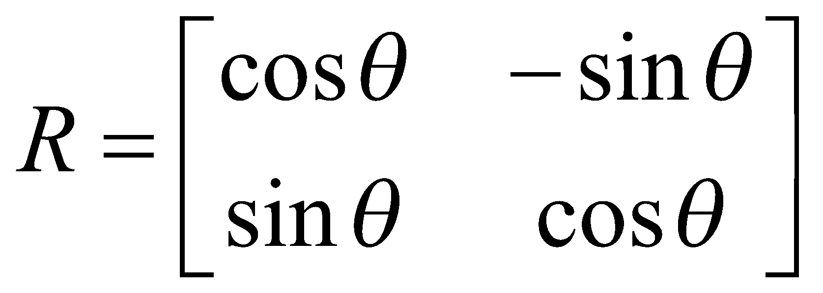
Rotation
We can write the components:
p'_{x} = p_{x} cos θ – p_{y} sin θ
p'_{y} = p_{x} sin θ + p_{y} cos θ
or in matrix form:
P' = R • P
θ can be clockwise (-ve) or counterclockwise (+ve as our example).
Rotation matrix
P’(x’, y’)
θ
y’
P(x,y)
θ
r
y
φ
x’
x

Slide 16
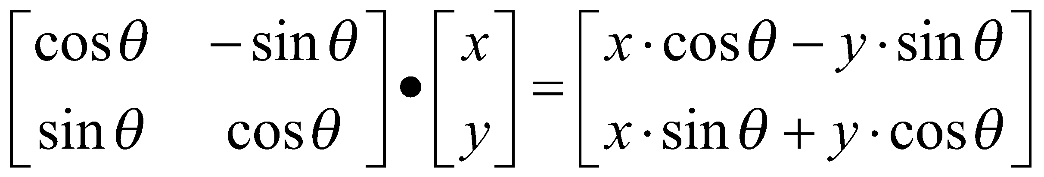
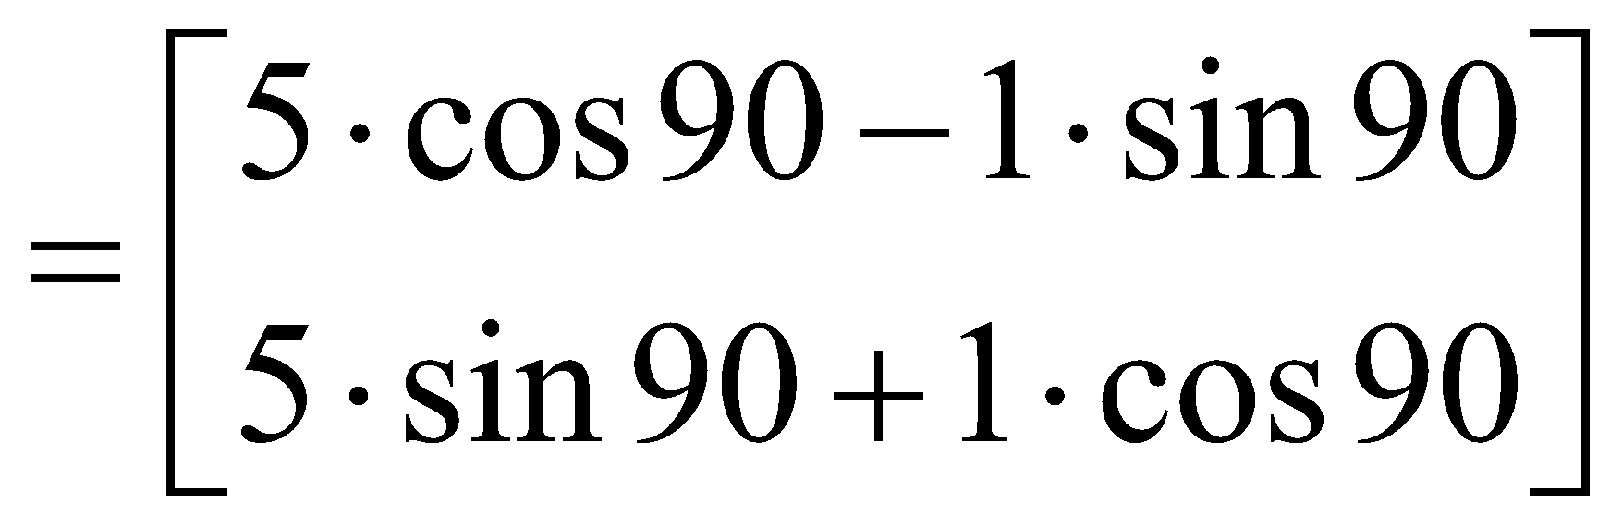
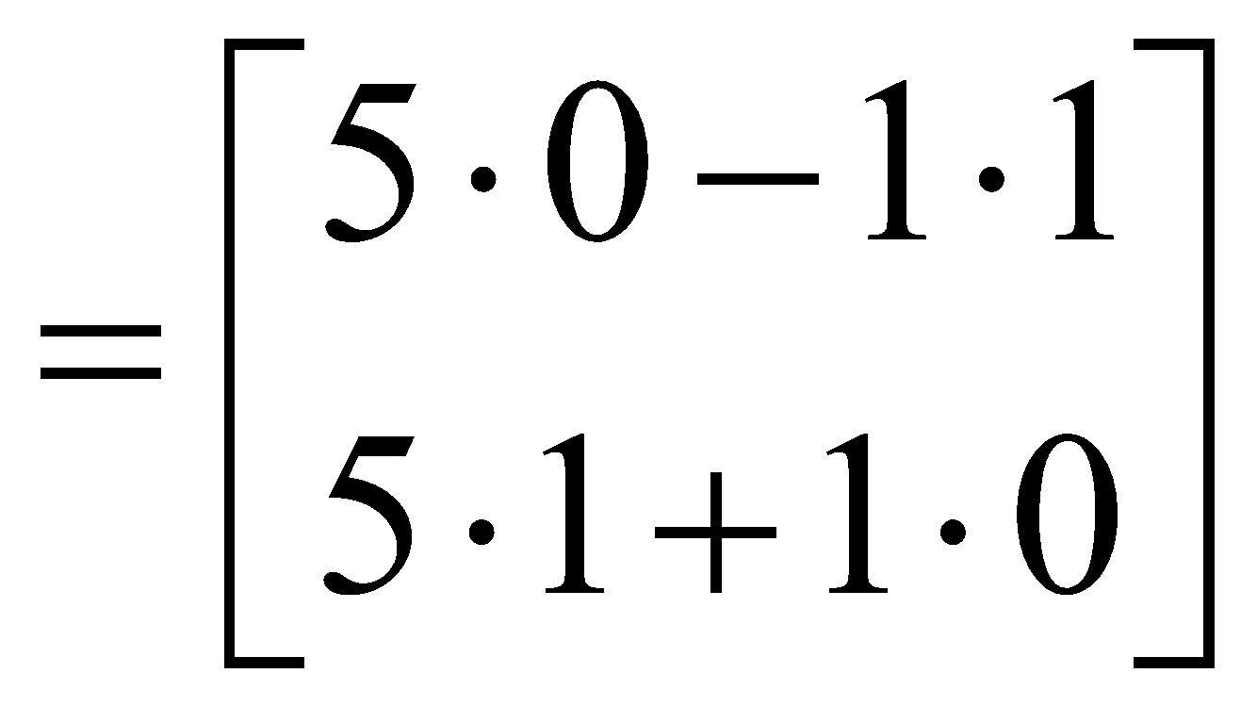
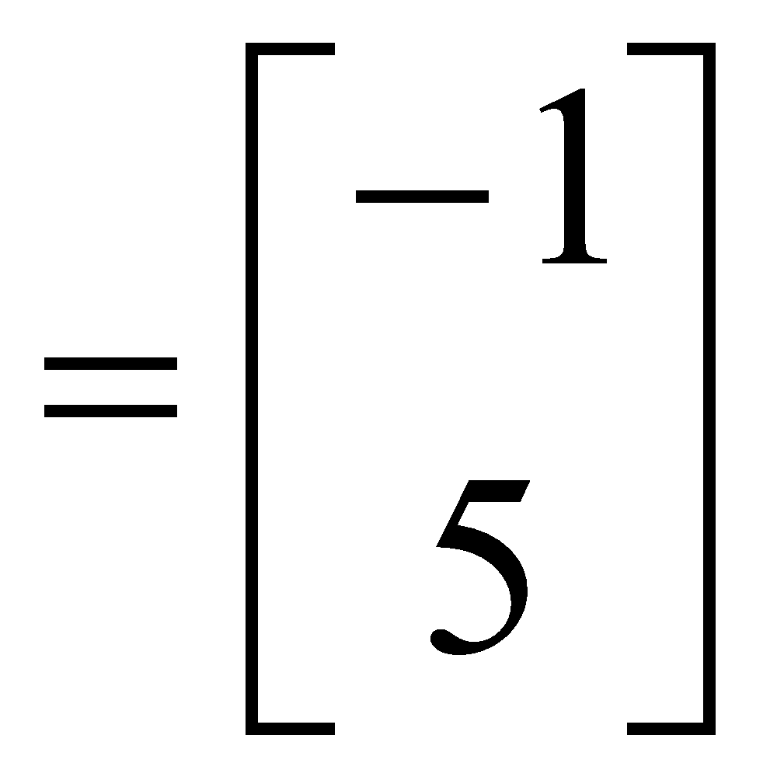
Rotation
Example
Find the transformed point, P’, caused by rotating P= (5, 1) about the origin through an angle of 90°.

Slide 17
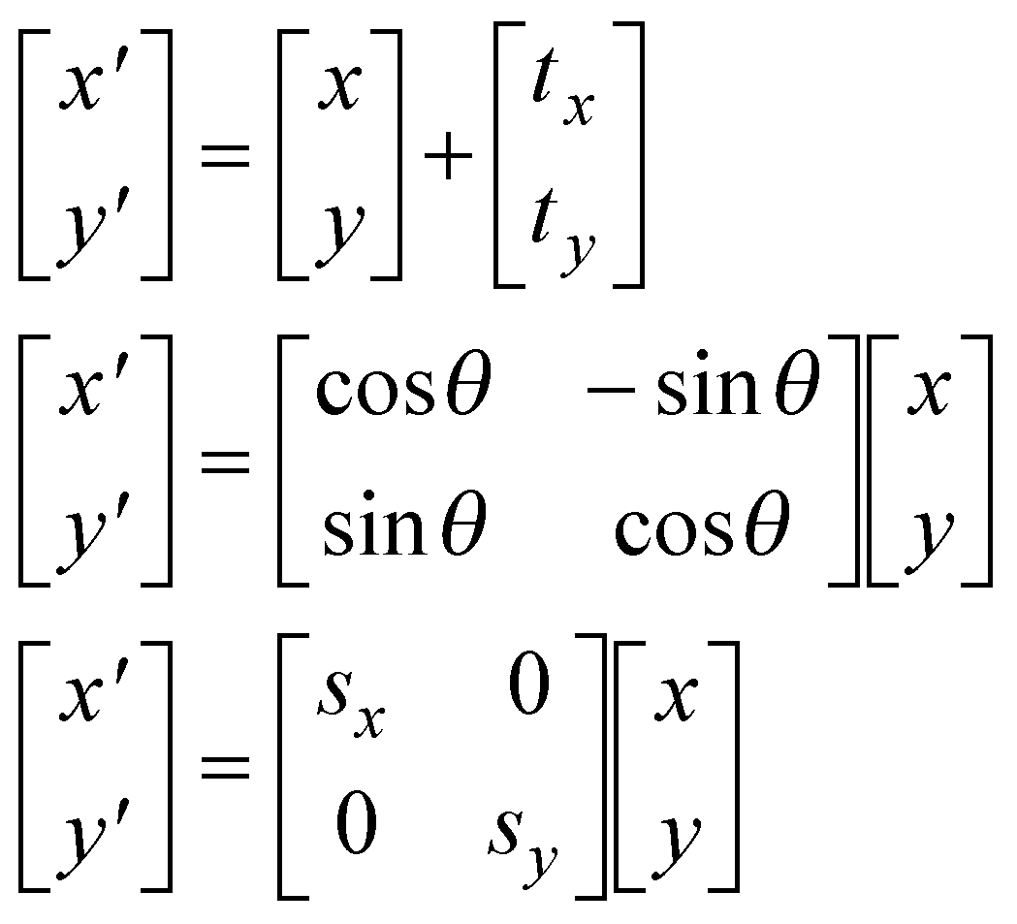
Matrix Representations
Translation
Rotation [Origin]
Scaling [Origin]

Slide 18
Combining transformations
We have a general transformation of a point:
P' = M • P + A
When we scale or rotate, we set M, and A is the additive identity.
When we translate, we set A, and M is the multiplicative identity.
To combine multiple transformations, we must explicitly compute each transformed point.
It’d be nicer if we could use the same matrix operation all the time. But we’d have to combine multiplication and addition into a single operation.

Slide 19
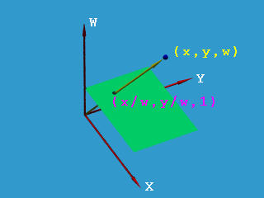
Homogeneous Coordinates
To obtain square matrices an additional row was added to the matrix and an additional coordinate, the w-coordinate, was added to the vector for a point. In this way a point in 2D space is expressed in three-dimensional homogeneous coordinates.
This technique of representing a point in a space whose dimension is one greater than that of the point is called Homogeneous Representation. It provides a consistent, uniform way of handling affine transformations.

Slide 20
Homogenous Coordinates
y
y
w
x
➔
x
Let’s move our problem into 3D.
Let point (x, y) in 2D be represented by point (x, y, 1) in the new space.
Scaling our new point by any value a puts us somewhere along a particular line: (ax, ay, a).
A point in 2D can be represented in many ways in the new space.
(2, 4) ----------→ (8, 16, 4) or (6, 12, 3) or (2, 4, 1) or etc.

Slide 21
Homogenous Coordinates
We can always map back to the original 2D point dividing by the last coordinate
(15, 6, 3) ---→ (5, 2).
(60, 40, 10) -→ ?.
Why do we use 1 for the last coordinate?
The fact that all the points along each line can be mapped back to the same point in 2D gives this coordinate system its name – homogeneous coordinates.

Slide 22
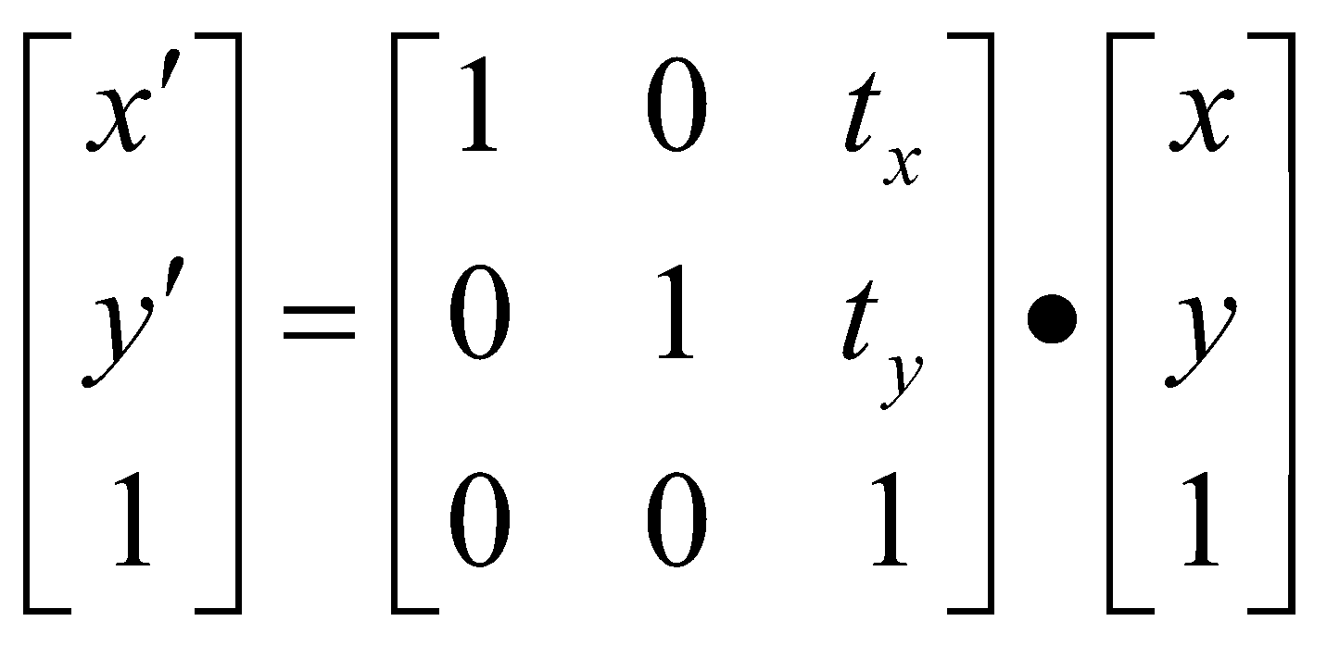
Matrix Representation
Point in column-vector:
Our point now has three coordinates. So our matrix is needs to be 3x3.
Translation
x
y
1

Slide 23
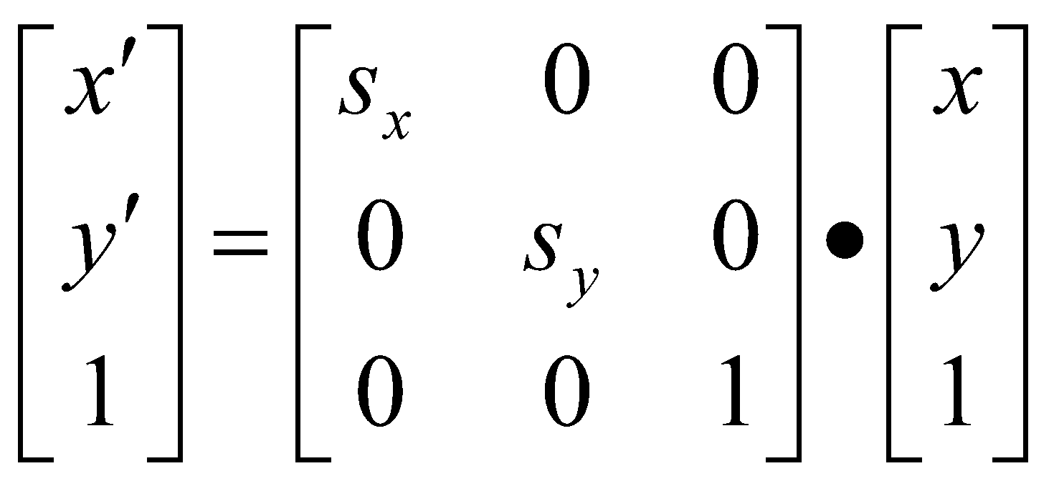
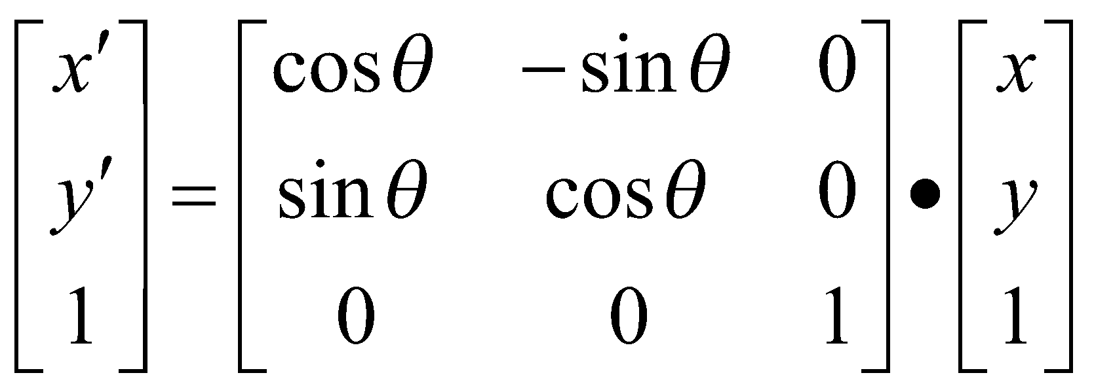
Matrix Representation
Scaling
Rotation

Slide 24
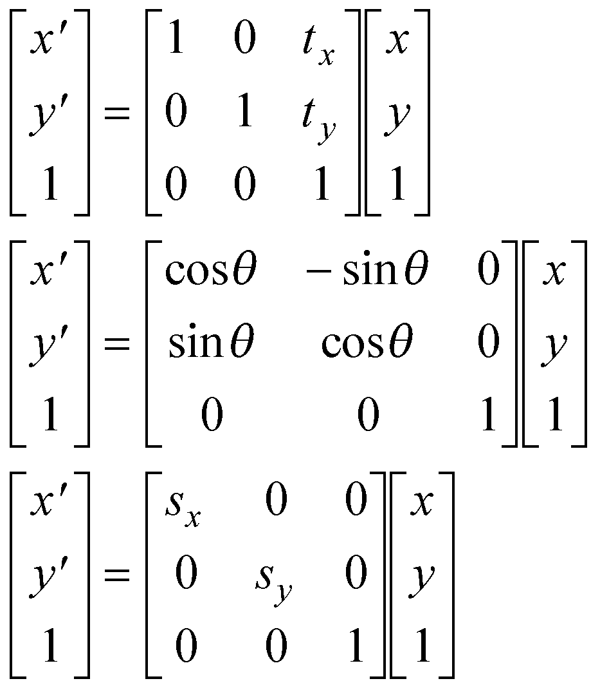
Homogeneous Coordinates
Basic Transformations
Translation
P’=TP
Rotation [O]
P’=RP
Scaling [O]
P’=SP

Slide 25
Composite Transformation
We can represent any sequence of transformations as a single matrix.
No special cases when transforming a point – matrix • vector.
Composite transformations – matrix • matrix.
Composite transformations:
Rotate about an arbitrary point – translate, rotate, translate
Scale about an arbitrary point – translate, scale, translate
Change coordinate systems – translate, rotate, scale
Does the order of operations matter?

Slide 26
Composition Properties
Is matrix multiplication associative?
(A.B).C = A.(B.C)
?
⎛
⎡
⎤
⎡
⎞
⎡
+
+
⎤
⎡
⎤
a
b
e
f
⎤
⎡
⎤
i
j
ae
bg
af
bh
i
j
⎜
⎢
⎥
∙
⎢
⎟
∙
=
∙
⎜
⎥
⎢
⎥
⎢
⎥
⎢
⎥
c
d
g
h
⎟
k
l
ce
+
dg
cf
+
dh
k
l
⎝
⎣
⎦
⎣
⎦
⎣
⎦
⎣
⎦
⎣
⎦
⎠
⎡
+
+
+
+
+
+
⎤
aei
bgi
afk
bhk
aej
bgj
afl
bhl
=
⎢
⎥
⎣
cei
+
dgi
+
cfk
+
dhk
cej
+
dgj
+
cfl
+
dhl
⎦
⎡
⎤
⎛
⎡
⎤
⎡
⎞
+
+
a
b
e
f
i
j
⎤
⎡
⎤
⎡
⎤
a
b
ei
fk
ej
fl
⎢
⎥
∙
⎜
⎢
⎥
∙
⎢
⎟
=
∙
⎜
⎥
⎢
⎥
⎢
⎥
c
d
g
h
k
l
⎟
c
d
gi
+
hk
gj
+
hl
⎣
⎦
⎝
⎣
⎦
⎣
⎦
⎣
⎦
⎣
⎦
⎠
⎡
+
+
+
+
+
+
⎤
aei
afk
bgi
bhk
aej
afl
bgj
bhl
=
⎢
⎥
cei
+
cfk
+
dgi
+
dhk
cej
+
cfl
+
dgj
+
dhl
⎣
⎦

Slide 27
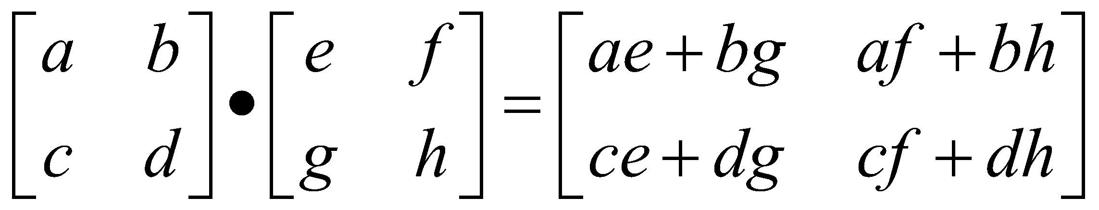
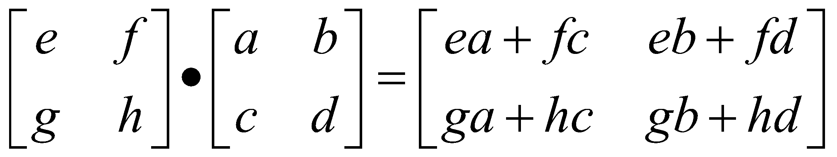
Composition Properties
Is matrix multiplication commutative?
A . B = B . A
?

Slide 28
Order of Transformations
In composite transformations, the order of transformations is very important
Rotation followed by Translation:
Translation followed by Rotation:

Slide 29
Order of operations
So, it does matter. Let’s look at an example:
Translate
Rotate
Rotate
Translate

Slide 30
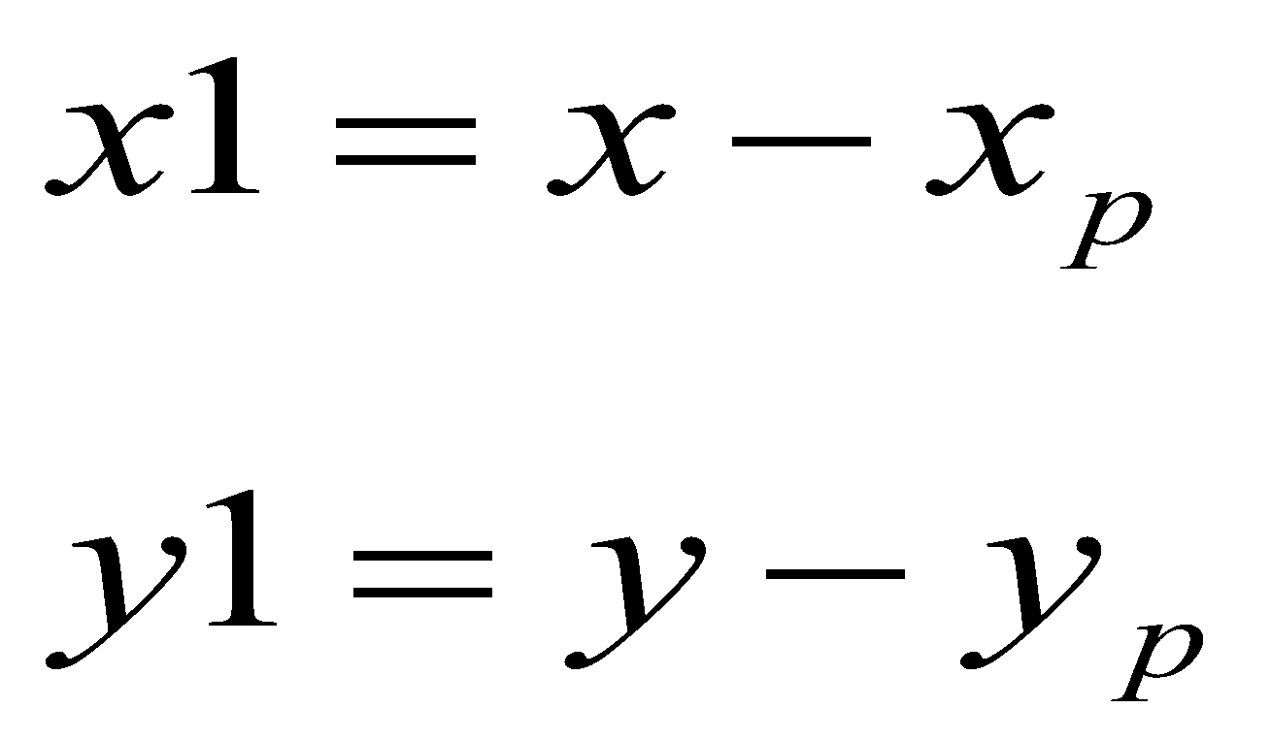
Rotation About a Pivot Point
STEP-1: Translate the pivot point to the origin
(x,y)
(x1, y1)
(x_{p} , y_{p})

Slide 31
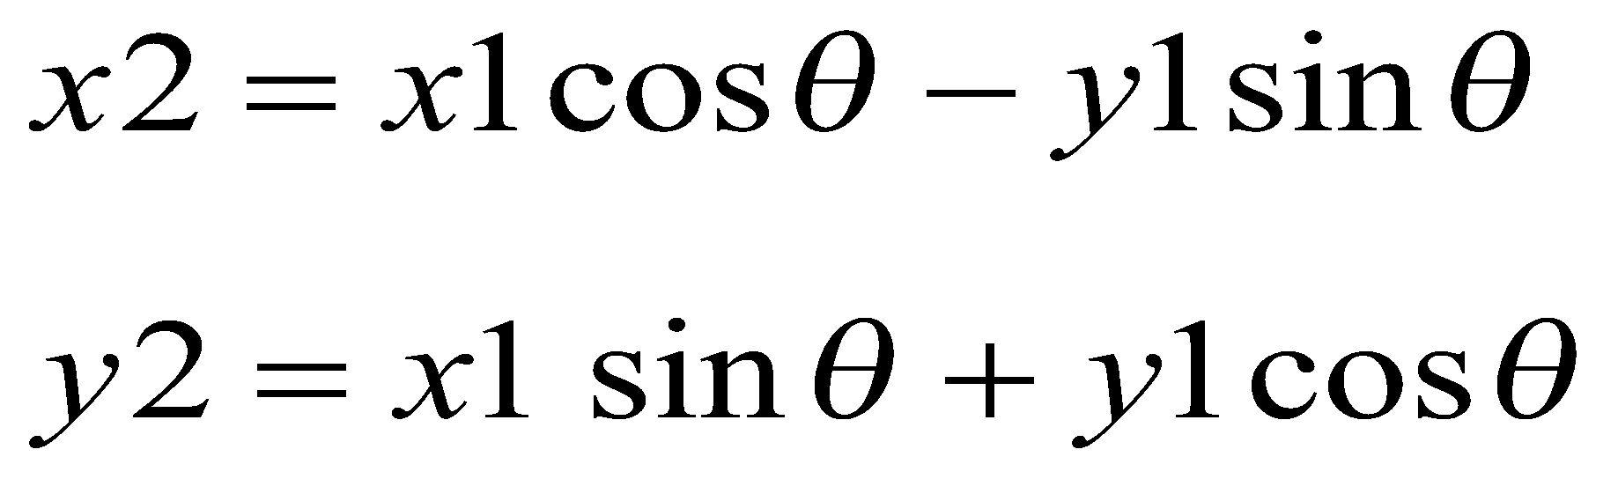
Rotation About a Pivot Point
STEP-2: Rotate about the origin
(x2, y2)
(x1, y1)

Slide 32
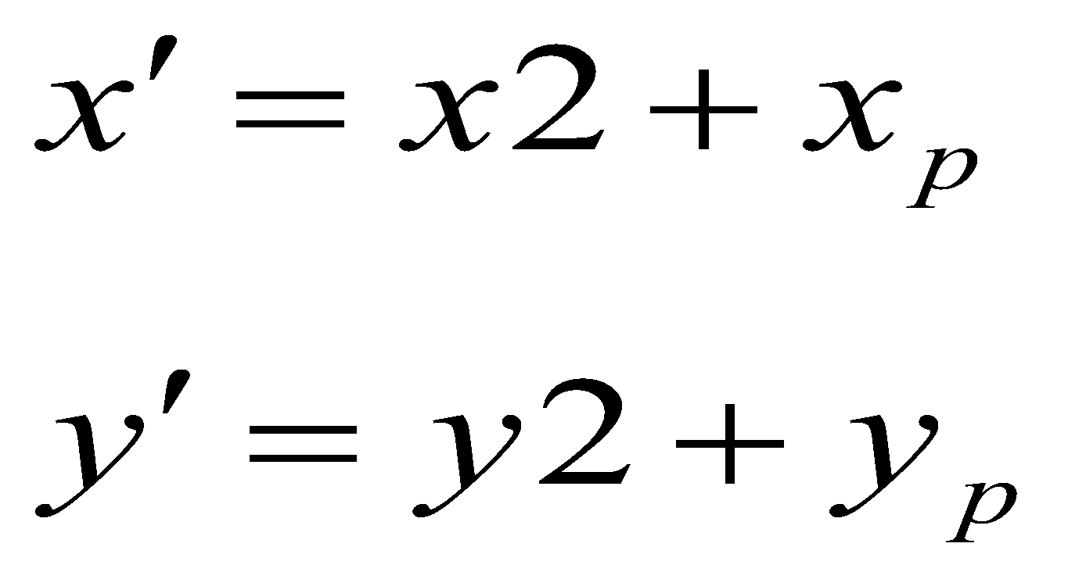
Rotation About a Pivot Point
STEP-3: Translate the pivot point to original position
(x’, y’)
(x2, y2)
(x_{p} , y_{p})

Slide 33
Composite Transformation Matrix
Arrange the transformation matrices in order from right to left.
General Pivot- Point Rotation
Operation :-
Translate (pivot point is moved to origin)
Rotate about origin
Translate (pivot point is returned to original position)
T(pivot) • R(θ) • T(–pivot)
1 0 t_{x}
0 1 t_{y}
0 0 1
cosθ -sinθ 0
sinθ cosθ 0
0 0 1
1 0 -t_{x}
0 1 -t_{y}
0 0 1
.
.
1 0 t_{x}
0 1 t_{y}
0 0 1
cosθ -sinθ -t_{x} cosθ+ t_{y} sinθ
sinθ cosθ -t_{x} sinθ - t_{y} cosθ
0 0 1
.
cosθ -sinθ -t_{x} cosθ+ t_{y} sinθ + t_{x}
sinθ cosθ -t_{x} sinθ - t_{y} cosθ + t_{y}
0 0 1

Slide 34
Composite Transformation Matrix
Example
Perform 60° rotation of a point P(2, 5) about a pivot point (1,2). Find P’?
cosθ -sinθ -t_{x} cosθ+ t_{y} sinθ + t_{x}
sinθ cosθ -t_{x} sinθ - t_{y} cosθ + t_{y}
0 0 1
x
y
1
Sin 60 = 0.8660
Cos 60 = 1/2
.
2
5
1
0.5 -0.866 -1.0.5 + 2.0.866 + 1
0.866 0.5 -1.0.866- 2.0.5 + 2
0 0 1
.
0.5 - 0.866 2.232
0.866 0.5 0.134
0 0 1
.
2
5
1
-1.098
4.366
1
=
P’ = (-1, 4)

Slide 35
Without using composite homogenous matrix
Example
Perform 90° rotation of a point P(5, 1) about a pivot point (2, 2). Find P’?
1. Translate pivot point ( tx = -2, ty = -2)
P(5, 1 ) → P’ (3, -1)
2. Rotate P ‘ = 90 degree
P’(3, -1) -- > cos 90 -sin 90 3 = 0 -1 3 = 1
sin 90 cos 90 -1 1 0 -1 3
3. Translate back ke pivot point (tx = 2 , ty = 2)
(1, 3 ) → (3, 5)

Slide 36
Composite Transformation Matrix
General Fixed-Point Scaling
Operation :-
Translate (fixed point is moved to origin)
Scale with respect to origin
Translate (fixed point is returned to original position)
T(fixed) • S(scale) • T(–fixed)
Find the matrix that represents scaling of an object with respect to any fixed point?
Given P(6, 8) , Sx = 2, Sy = 3 and fixed point (2, 2). Use that matrix to find P’?

Slide 37
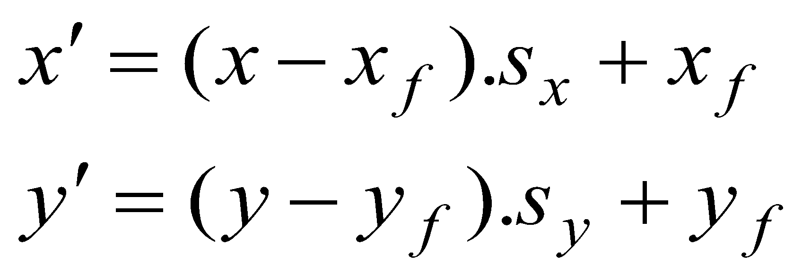
Scaling About a Fixed Point
Translate the fixed point to origin
Scale with respect to the origin
Translate the fixed point to its original
position.
(x,y)
(x’,y’)
(x_{f} , y_{f} )

Slide 38
Answer
1 0 t_{x}
0 1 t_{y}
0 0 1
Sx 0 0
0 Sy 0
0 0 1
1 0 -t_{x}
0 1 -t_{y}
0 0 1
.
.
Sx 0 -t_{x} Sx
0 Sy -t_{y} Sy
0 0 1
1 0 t_{x}
0 1 t_{y}
0 0 1
Sx 0 -t_{x} Sx + t_{x}
0 Sy -t_{y} Sy + t_{y}
0 0 1
.
=
x =6, y = 8, Sx = 2, Sy = 3, t_{x} =2, t_{y} = 2
2 0 -2( 2) + 2
0 3 -2(3) + 2
0 0 1
6
8
1
10 20 1
.
=

Slide 39
Composite Transformation Matrix
General Scaling Direction
Operation :-
1. Rotate (scaling direction align with the coordinate axes)
2. Scale with respect to origin
3. Rotate (scaling direction is returned to original position)
R(–θ) • S(scale) • R(θ)
Find the composite transformation matrix
by yourself !!

Slide 40
S . T . R
Sx 0 0
0 Sy 0
0 0 1
1 0 t_{x}
0 1 t_{y}
0 0 1
cosθ -sinθ 0
sinθ cosθ 0
0 0 1
.
.
Sx 0 0
0 Sy 0
0 0 1
cosθ -sinθ t_{x}
sinθ cosθ t_{y}
0 0 1
.
Sxcosθ Sx(-sinθ) Sx t_{x} Sy sinθ Sy cosθ Sy t_{y}
0 0 1

Slide 41
Reflections
y
Reflection about y
x′ = − x
Initial
Object
x
Reflection about
origin
x′ = − x
y′ = − y
Reflection about x
y′ = − y

Slide 42
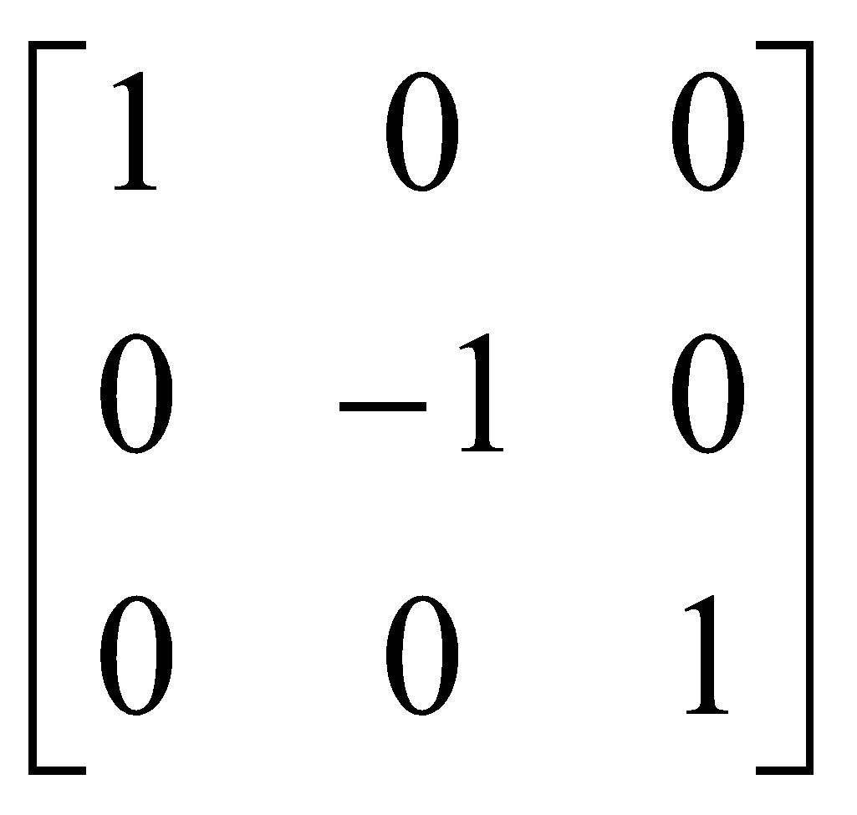
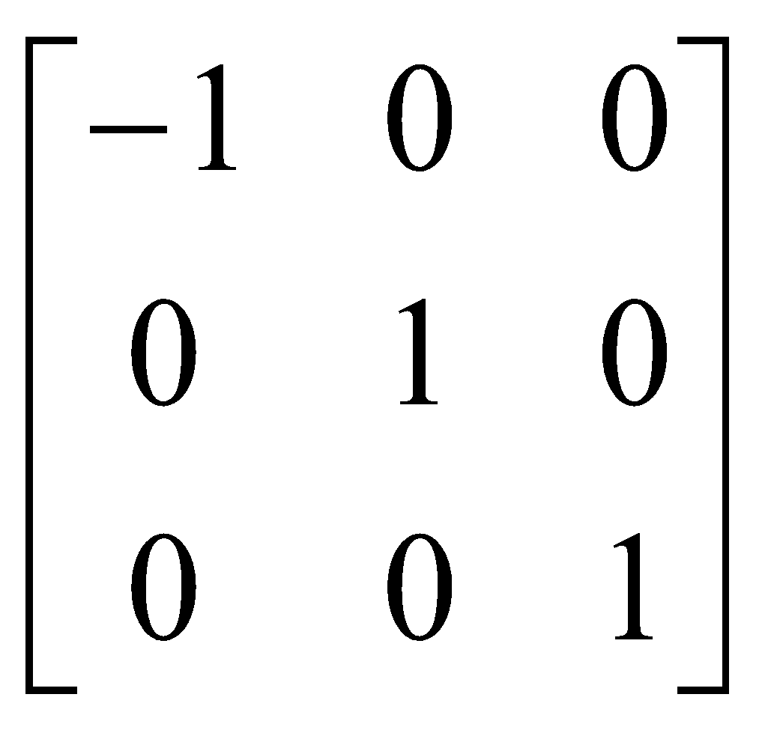
Other transformations
Reflection:
x-axis y-axis

Slide 43
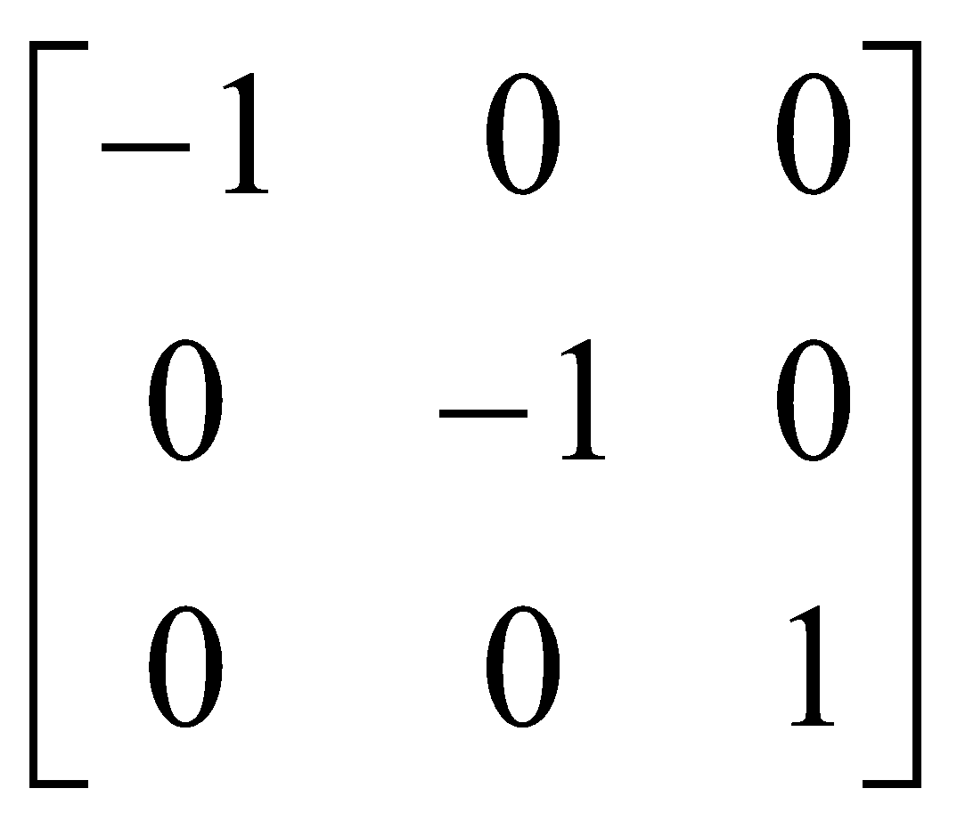
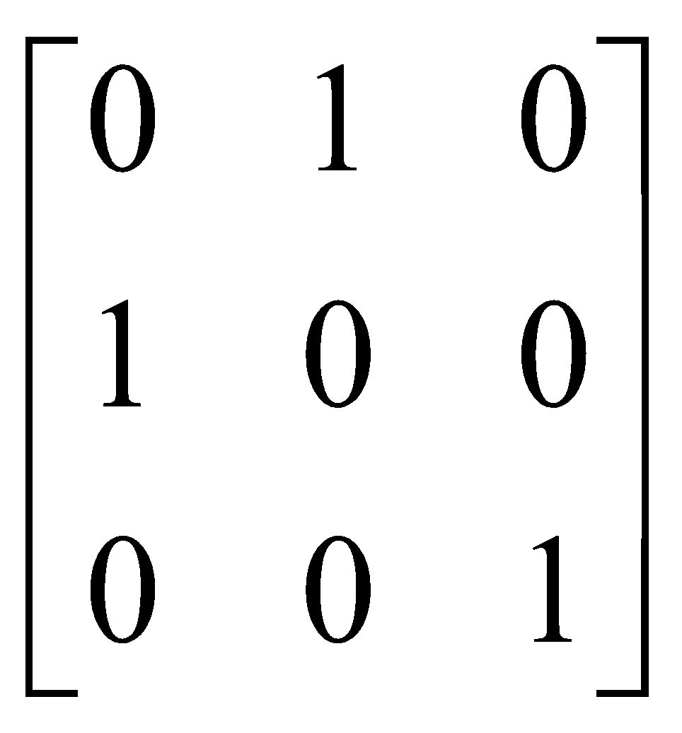
Other transformations
Reflection:
origin line x=y

Slide 44
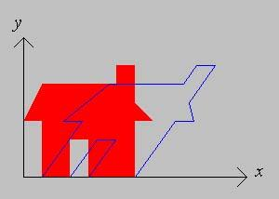
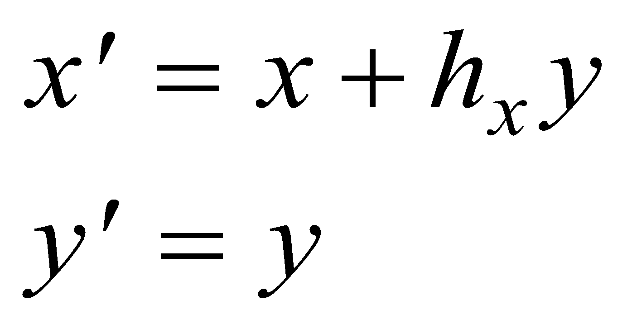
Shear
A shear transformation in the x-direction (along x)
shifts the points in the x-direction proportional
to the y-coordinate.
The y-coordinate of each point is unaffected.

Slide 45
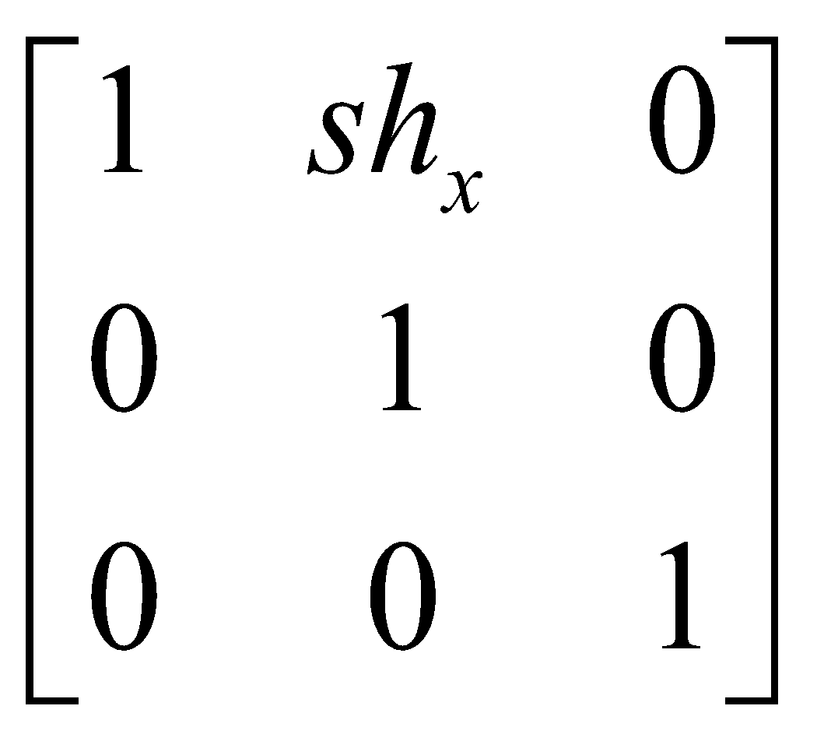
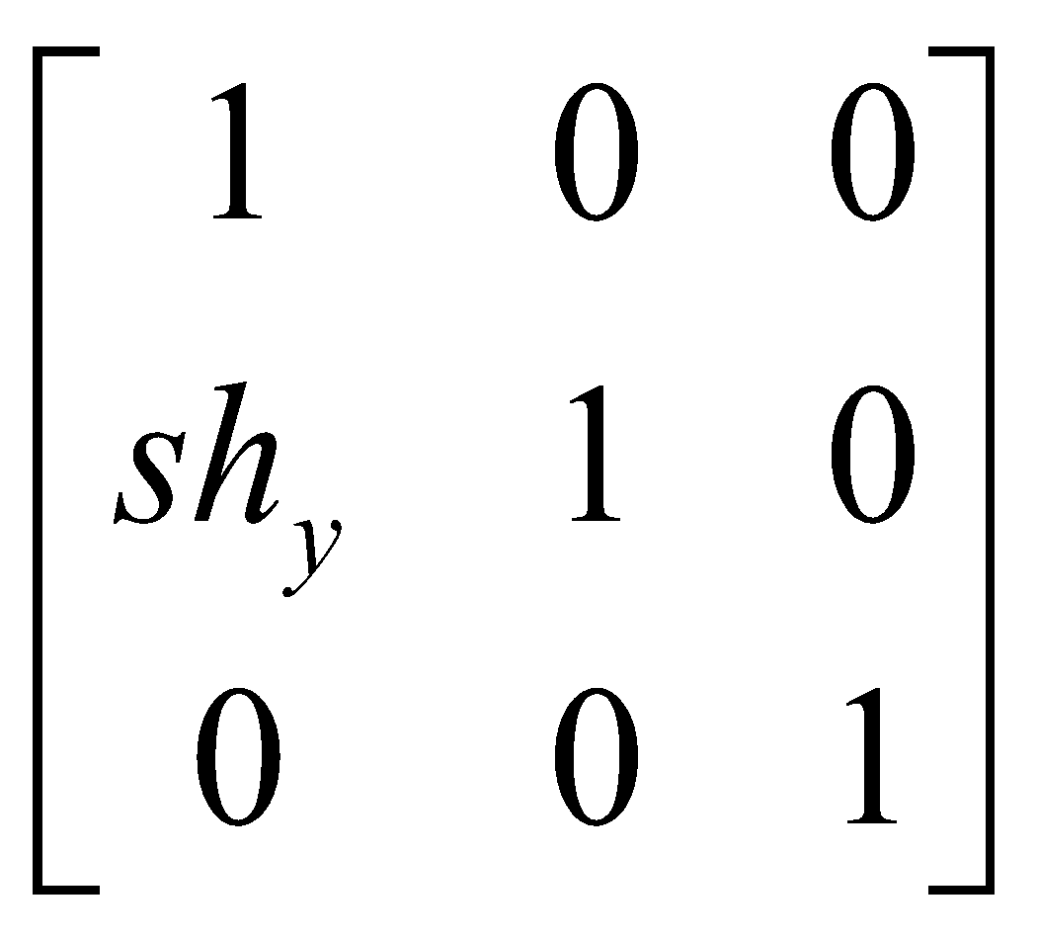
Other transformations
Shear:
x-direction y-direction

Slide 46
Coordinate System Transformations
We often need to transform points from one coordinate system to another:
We might model an object in non-Cartesian space (polar)
Objects may be described in their own local system
Other reasons: textures, display, etc

